Slide 1
Goal-Oriented Game AI
Purpose and Utilizations
Research Organized by: Evan Schipellite

Slide 2
What is GOB?
Goal-Oriented Behavior (GOB)
Make use of Motives / Desires to guide AI Characters
Examine the most ‘pressing’ goals and choose an action
The action reflects two key aspects of the algorithm
  The action serves to satisfy the current goal of importance
  The action results in the least ‘negative aftermath’

Slide 3
GOB in Contemporary Games
Goal-Oriented Behavior allows for simple AI construction
  It can be useful, making simple AI appear realistic
  Not for all games, as it pertains more to ‘undirected’ AI
Generally, GOB is useful when a Game:
  Needs numerous side-characters that can appear life-like
    But, these characters are not directly controllable by gameplay
  Needs to recreate a simulation (People, Animals, Plants)
  Needs to provide AI with sub-actions within a state-machine
    RTS units may begin working on the most pressing tasks if not specifically tasked by the player

Slide 4
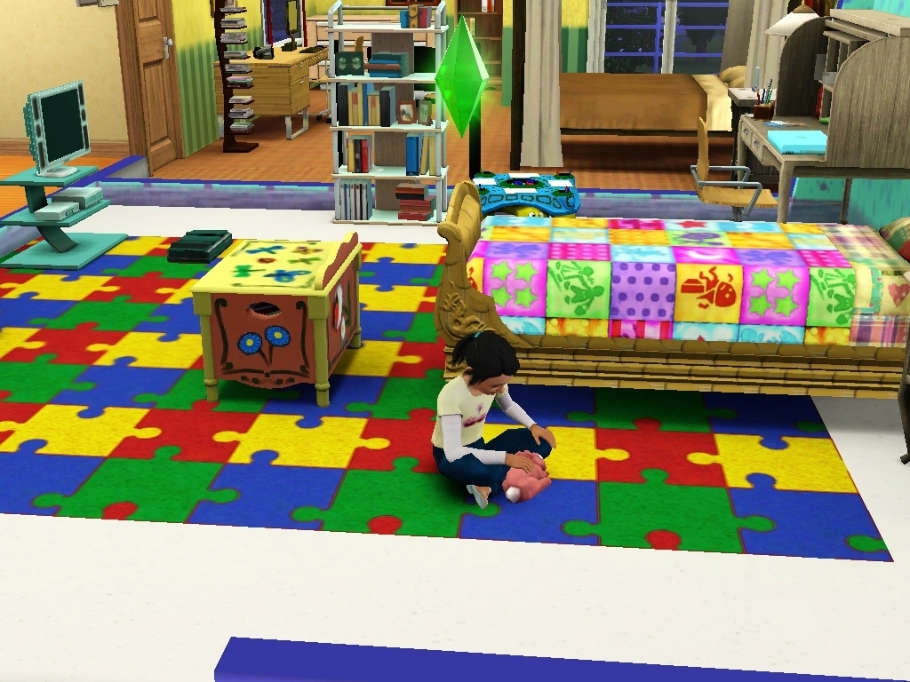
The Sims 3 (The Sims Studio)

Slide 5
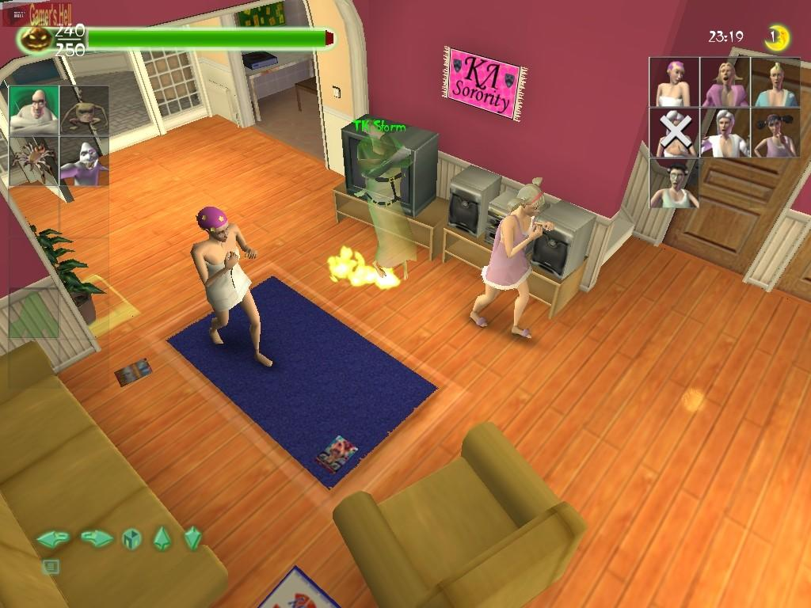
Ghost Master (Sick Puppies)

Slide 6
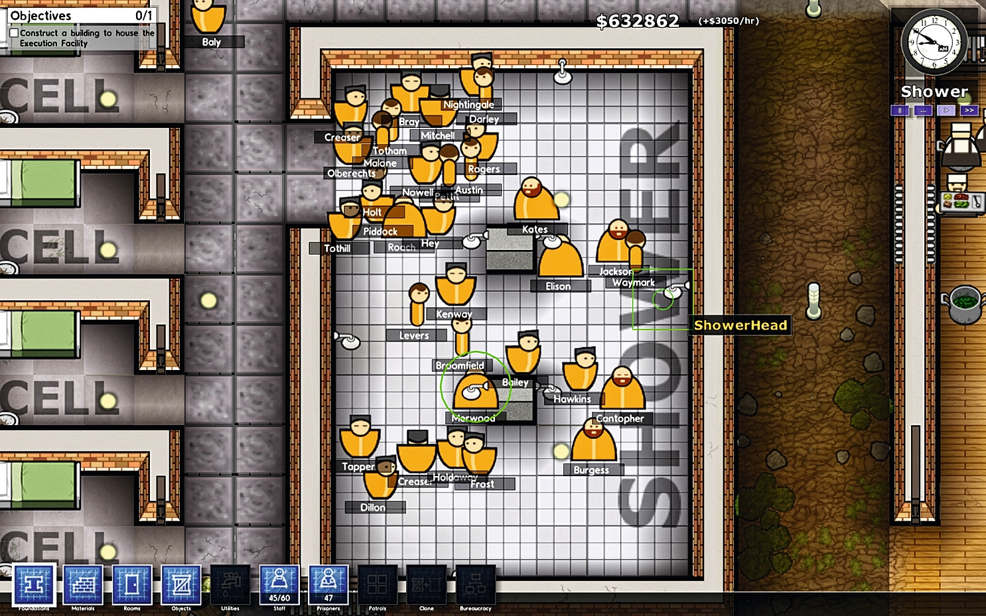
Prison Architect (Introversion Software)

Slide 7
So, What’s Going on in These Games?
Player interacts with units that are not fully controllable.
However, these units can be persuaded
Sims 3 → Player works to satisfies the needs / desires of the residents
Ghost Master → Player positions independent ghosts in order to construct the best scaring environment
Prison Architect → Player monitors the psychology of the prisoners to improve the facility and plan their schedule
The Purpose is to create simple AI to choose and act in realistic ways

Slide 8
Goals
“goals describe some desired state of the world… we want to reach“ (Jeff Orkin)
Goals can be consider insistences (Ian Millington).
  As a Goal’s rate increases, its insistences declares it a priority
Goals represent traits or states that we want to complete, or reduce the insistence of

Slide 9
Actions
“actions are defined in terms of preconditions and effects” (Jeff Orkin)
"present the character with a suite of possible actions and have it choose the one that best meets its immediate needs” (Ian Millington)
An Action serves as a means to complete a Goal.

Slide 10
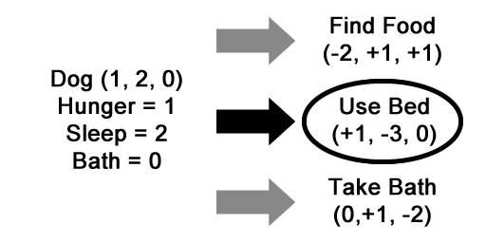
‘Sleep’ is the highest priority. 3 actions are available.
  The best route involves ‘Use Bed’
  It will reduce the insistence of ‘Sleep’ the most
  But, what if the numbers are not so obvious?

Slide 11
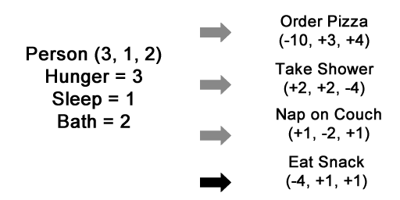
‘Hunger’ is highest priority. There are 4 possible actions.
  However, two actions involve satisfying ‘Hunger’
  The difference between ‘Hunger’ and ‘Bath’ is not much
In this case, overall insistence is taken into account
  The AI does not simply choose the highest priority
  It analyzes the overall discontentment (Ian Milliginton)

Slide 12
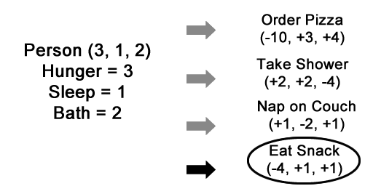
All Goal values (Hunger, Sleep, Bath) are analyzed
  The AI notes their resulting values from each action
Therefore,
  ‘Order Pizza’ would result in (0, 4, 6)
  ‘Eat Snack’ would result in (0, 2, 3)
‘Eat Snack’ is chosen to minimalize discontentment

Slide 13
How does the GOB Algorithm Work?
Ultimately, the Answer is: In Many Different Ways
Essentially, the algorithm is constructed by taking into account Goals and Actions.
The AI evaluates the discontentment that would result from any given action, thus providing the best action

Slide 14
How does the GOB Algorithm Work?
To generate the best action
  Utilize the current status of Goals and possible Actions
  Then loop through the Actions, searching for the least discontentment result
  Discontentment can be calculated by adding
    All of the current Goal values
    All of the resulting Goal changes in the Action

Slide 15
The Result of GOB
In its simplest form, the highest rated goal may lead to an action
Additional complexities can be developed by the programmer
  Add in time durations to Actions
    Additional changes are addeds to discontentment based on the time it may take to complete a task
  Resolve incidents where Actions become unavailable
    Have a unit continue another action while waiting
  Have units take into account distance / obstacles
    Actions may carry more weight depending on position, health, status, inventory, etc.
Depending on the game, these features can be further developed to make the AI appear independent

Slide 16
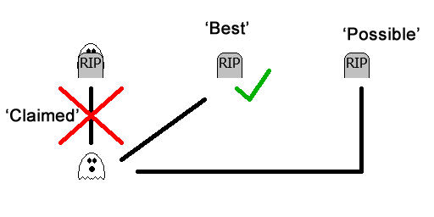
Example Adjustments
AI can ‘claim’ facilities, thus limiting their availability
AI can ‘claim’ the closest available facilities

Slide 17
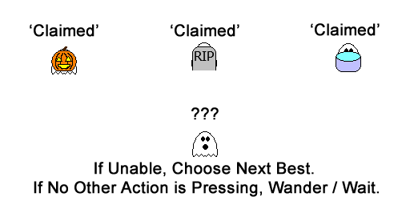
Example Adjustments
If desired Actions are unavailable
  The AI can revaluate their actions and choose the next best
If no Actions are available, the AI can wander instead

Slide 18
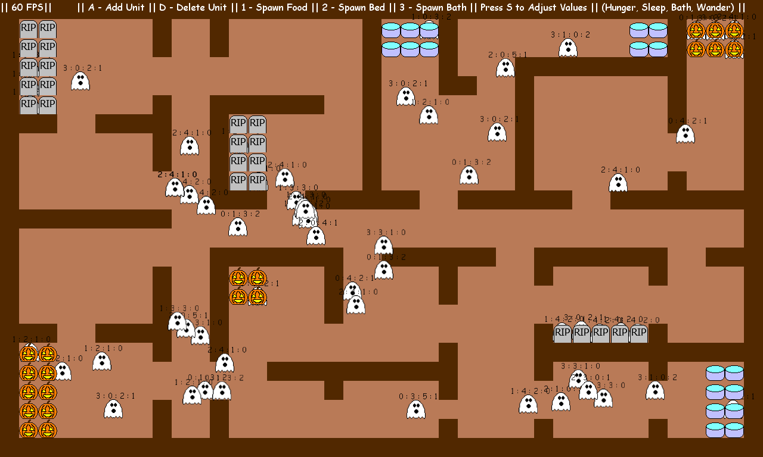
Basic Goal-Oriented Behavior in Practice

Slide 19
Additional GOB Information
"goal instances can be dynamically generated and destroyed“ (Denis Papp)
  AI should be able to react to changes in the environment and their possible needs
"needs to look at the situation in which it wants to be, and then work backwards from it to calculate the best way of achieving the desired result“ (Ben Hardwidge)
  Essentially, the AI should take what it wants to do, and then figure out which path will net that result in the best possible way.
  Be careful with how much knowledge is provided.
    Ex: If the Ai is trying to get to work, should it know about the delayed train before it arrives at the station?

Slide 20
Additional GOB Information
Planning System → “benefit is the ability to decouple goals and actions, to allow different types of characters to satisfy goals in different ways. The second benefit of a planning system is facilitation of layering simple behaviors to produce complex observable behavior“ (Jeff Orkin)
  Design the GOB algorithm to be reusable by different units
  Complex behaviors can result from simple combinations
"A goal is active if it is currently reasonable to execute it“ (Denis Papp)
  Should the AI even complete a goal if it is not high enough priority?
    Ex: Should the AI sleep just because there are not other pressing tasks?

Slide 21
Sources
Millington, Ian, and John David Funge. Artificial Intelligence for Games. Burlington, MA: Morgan Kaufmann/Elsevier, 2009. Print.
Orkin, Jeff. “Three States and a Plan: The A.I. of F.E.A.R.” Monolith Productions / M.I.T. Media Lab, Cognitive Machines Group. Web. <http://web.media.mit.edu/~jorkin/gdc2006_orkin_jeff_fear.pdf>.
Hardwidge, Ben. “How AI in Games Works: The Planning System.” bitGamer. Web. 5 March, 2009. <http://www.bit-tech.net/gaming/2009/03/05/how-ai-in-games-works/3>.
Papp, Denis. “A Goal-Based Architecture for Opposing Player AI.” The Association for the Advancement of Artificial Intelligence. Web. <http://www.aaai.org/Papers/AIIDE/2005/AIIDE05-006.pdf>.

Slide 22
Image Sources
Sims 3
  http://images4.fanpop.com/image/photos/20500000/Sims-3-gameplay-the-sims-3-20554616-1024-768.jpg
Ghost Master
  http://www.beamdog.com/assets/products/2953/original/Ghostmaster_Screen_4.jpg?1284488130
Prison Architect
  http://media.pcgamer.com/files/2011/11/Prison-Architect-preview-2.jpg

